Slide 1


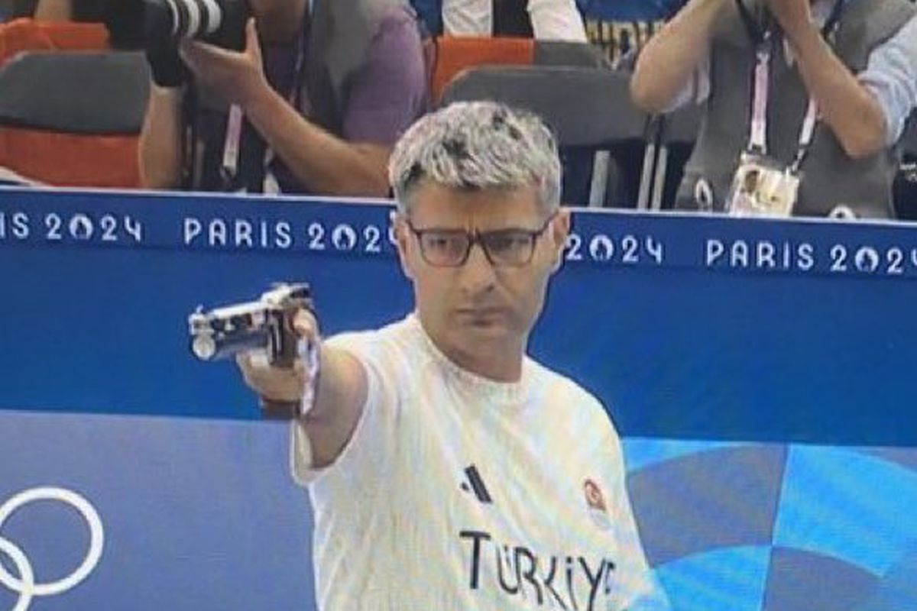
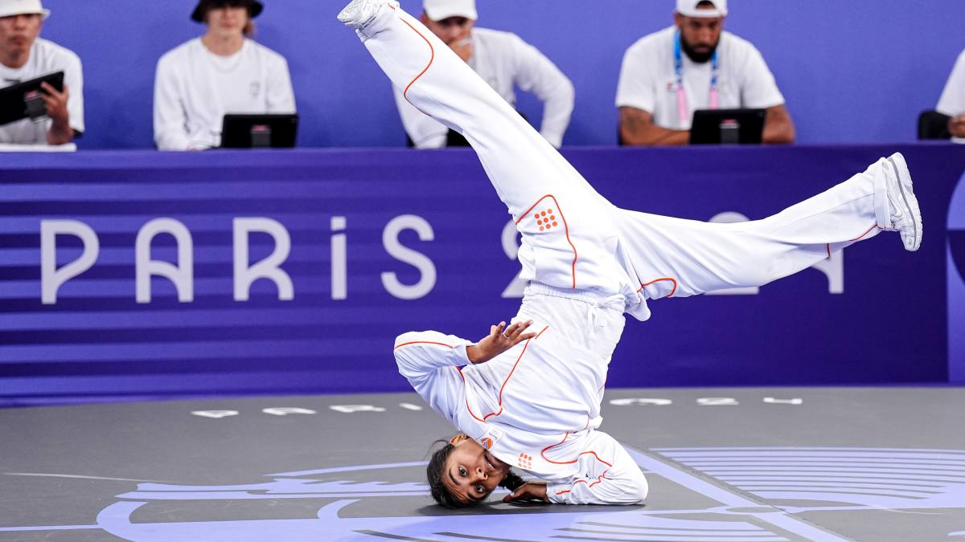
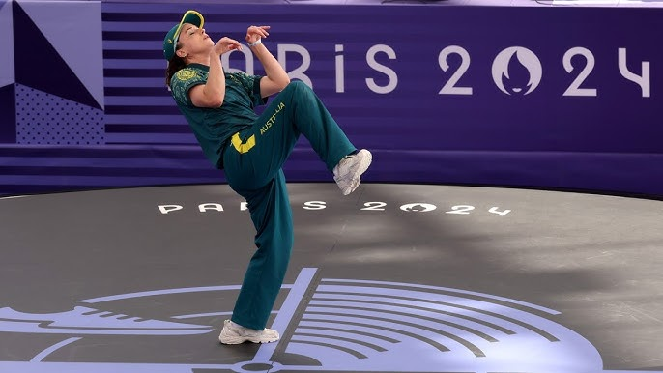

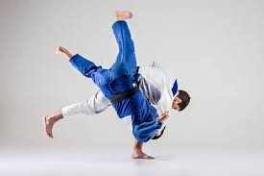


Slide 2



Olympic Performance Analysis Based on Medals
CZ4124/SC4024 Data Visualisation

Slide 3



Slide 4




Slide 5




Slide 6


Slide 8


Slide 9
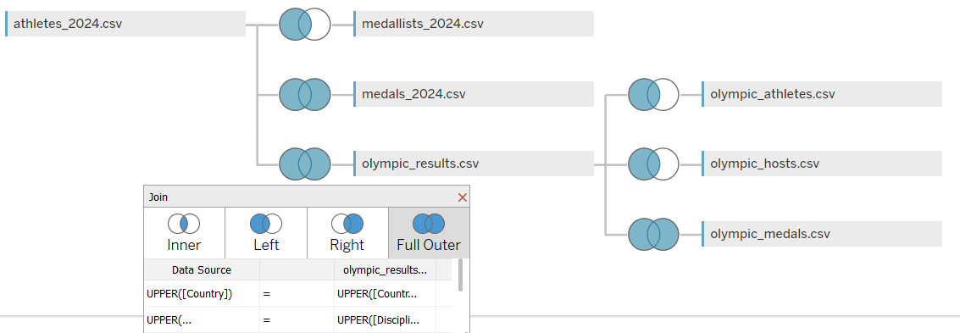
Olympic 2024
Olympic 1896 - 2022

